Slide 1
Artificial Intelligence
Exact inference, Sampling
Notes:
Slides and exercises are inspired by Russell & Norvig AI Book, Stanford’s AI course and from Berkeley’s AI course

Slide 2
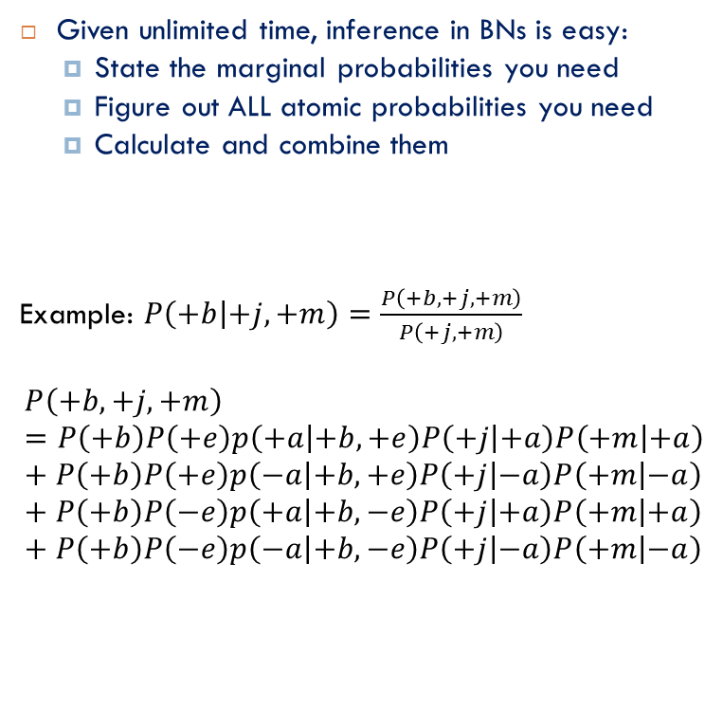
Exact inference (by enumeration)
Given unlimited time, inference in BNs is easy:
State the marginal probabilities you need
Figure out ALL atomic probabilities you need
Calculate and combine them
Example: $P\left(+b | +j,+m\right)=\frac{P\left(+b,+j,+m\right)}{P\left(+j,+m\right)}$
$$P\left(+b,+j,+m\right)=P\left(+b\right)P\left(+e\right)p\left(+a | +b,+e\right)P\left(+j | +a\right)P\left(+m | +a\right)+P\left(+b\right)P\left(+e\right)p\left(−a | +b,+e\right)P\left(+j | −a\right)P\left(+m | −a\right)+P\left(+b\right)P\left(−e\right)p\left(+a | +b,−e\right)P\left(+j | +a\right)P\left(+m | +a\right)+P\left(+b\right)P\left(−e\right)p\left(−a | +b,−e\right)P\left(+j | −a\right)P\left(+m | −a\right)$$
Burglary
Earthquake
Alarm
John Calls
Marry Calls

Slide 3
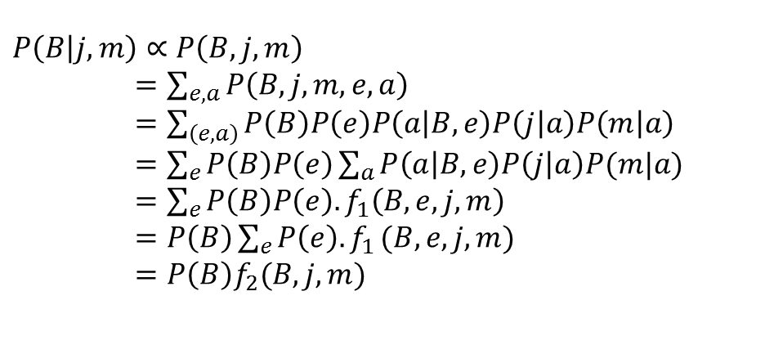
Variable elimination
Why is inference by enumeration so slow;
We join up the whole joint distribution before we sum out the hidden variables
Idea: can we re-order the computation in a more efficient way?
This is called Variable elimination
Still NP-hard, but usually much faster than inference by enumeration
Example:
$$P\left(B | j,m\right)∝P\left(B,j,m\right)$$
$=\sum_{e,a}{P\left(B,j,m,e,a\right)}$
$=\sum_{\left(e,a\right)}{P\left(B\right)P\left(e\right)P\left(a | B,e\right)P\left(j | a\right)P\left(m | a\right)}$
$=\sum_{e}{P\left(B\right)P\left(e\right)\sum_{a}{P\left(a | B,e\right)P\left(j | a\right)P(m|a)}}$
$=\sum_{e}{P\left(B\right)P\left(e\right).f_{1}\left(B,e,j,m\right)}$
$=P\left(B\right)\sum_{e}{P\left(e\right){.f}_{1}(B,e,j,m)}$
$=P\left(B\right)f_{2}(B,j,m)$
Factors having hidden variable A
Factors having hidden variable E
Notes:
It can be shown that exact inference can be reduced to the 3‐SAT problem which is NP-hard.

Slide 4


What is a factor?
any multi-dimensional array of the form $P\left(Y_{1},…, Y_{N}\right|X_{1},…, X_{N})$
Any variable in the factor can be assigned or not
Variable elimination is to alternately join factors and eliminate variables
Query: $P\left(Q | E_{1}=e_{1},…, E_{k}=e_{k}\right)$
Start with initial factors:
Local CPTs (but instantiated by evidence)
While there are still hidden variables (not Q or evidence):
Pick a hidden variable H
Join all factors mentioning H
Eliminate (sum out) H
Join all remaining factors and normalize

Slide 5

Example
B
E
A
$$P(B|j,m)∝P(B,j,m)$$
J
M
P(B) P(E) P(A|B,E) P(j|A) P(m|A)
Choose A
P(A|B,E)
P(j,A)
P(m,A)
Initial factors
X
∑
P(j,m,A|B,E)
P(j,m|B,E)
P(B) P(E) P(j,m|B,E)

Slide 6
Example – cont.
B
E
A
$$P(B|j,m)∝P(B,j,m)$$
J
M
P(B) P(E) P(j,m|B,E)
Choose E
P(E)
P(j,m|B,E)
X
∑
P(j,m,E|B)
P(j,m|B)
P(B) P(j,m|B)
Finish with B
P(B)
P(j,m|B)
X
normalize
P(j,m,B)
P(B|j,m)

Slide 7
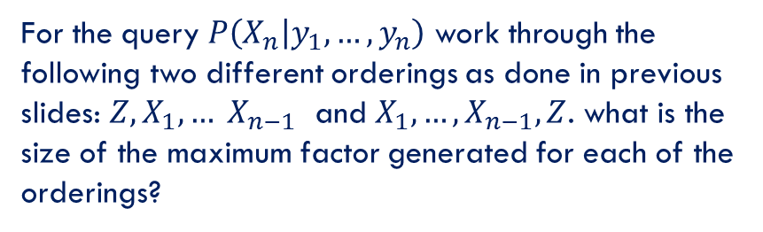
Variable elimination ordering
For the query $P\left(X_{n} | y_{1},…,y_{n}\right)$ work through the following two different orderings as done in previous slides: $Z, X_{1}, … X_{n−1}$ and $X_{1}, …, X_{n−1}, Z$. what is the size of the maximum factor generated for each of the orderings?
Z
X₁
X₂
X_{n-1}
X_{n}
…
Y₁
Y₂
Y_{n-1}
Y_{n}
…
Notes:
A polytree is a directed graph with no undirected cycles
For polytrees you can always find an ordering that is efficient

Slide 8
Variable elimination ordering
For the query $P\left(X_{n} | y_{1},…,y_{n}\right)$ work through the following two different orderings as done in previous slides: $Z, X_{1}, … X_{n−1}$ and $X_{1}, …, X_{n−1}, Z$. what is the size of the maximum factor generated for each of the orderings?
Answer: 2^{n+1} versus 2² (assuming binary)
In general the ordering can greatly affect efficiency
Z
X₁
X₂
X_{n-1}
X_{n}
…
Y₁
Y₂
Y_{n-1}
Y_{n}
Does there always exist an ordering that only results in small factors?
No!
…
Notes:
A polytree is a directed graph with no undirected cycles
For polytrees you can always find an ordering that is efficient

Slide 9

How to eliminate one variable?
Task: Eliminate B
Join on B
$$f_{5}^{′} \left(A,B,D,E\right)= f_{1}\left(A,B\right). f_{3}\left(A,B,D\right).f_{4}\left(B,E\right)$$
Sum over B
$$f_{5}\left(A,D,E\right)=\sum_{b}{f_{5}^{′}\left(A,b,D,E\right)}$$
We are left with only two factors: f₅(A,D,E) and f₂(A,C)
A | B | f₁(A,B)
+a | +b | 0.3
+a | -b | 0.6
-a | +b | 0.2
-a | -b | 0.5
A | C | f₂(A,C)
+a | +c | 0.8
+a | -c | 0.9
-a | +c | 0.2
-a | -c | 0.3
A | B | D | E | f’₅
+a | +b | +d | +e | _{0.3*0.6*0.2}
+a | +b | +d | -e | _{0.3*0.6*0.8}
+a | +b | -d | +e | _{0.3*0.3*0.2}
…
A | B | D | F₃(A,B,D)
+a | +b | +d | 0.6
+a | +b | -d | 0.3
+a | -b | +d | 0.2
+a | -b | -d | 0.5
-a | +b | +d | 0.4
-a | +b | -d | 0.1
-a | -b | +d | 0.8
-a | -b | -d | 0.9
B | E | f₄(B,E)
+b | +e | 0.2
+b | -e | 0.8
-b | +e | 0.3
-b | -e | 0.6

Slide 10
Sum over B
A | B | D | E | f’₅
+a | +b | +d | +e | _{0.3*0.6*0.2=0.036}
+a | +b | +d | -e | _{0.3*0.6*0.8=0.144}
+a | +b | -d | +e | _{0.3*0.3*0.2=0.018}
+a | +b | -d | -e | _{0.3*0.3*0.8=0.072}
+a | -b | +d | +e | _{0.6*0.2*0.3=0.036}
+a | -b | +d | -e | _{0.6*0.2*0.6=0.072}
+a | -b | -d | +e | _{0.6*0.5*0.3=0.090}
+a | -b | -d | -e | _{0.6*0.5*0.6=0.180}
-a | +b | +d | +e | _{0.2*0.4*0.2=0.016}
-a | +b | +d | -e | _{0.2*0.4*0.8=0.064}
-a | +b | -d | +e | _{0.2*0.1*0.2=0.004}
-a | +b | -d | -e | _{0.2*0.1*0.8=0.016}
-a | -b | +d | +e | _{0.5*0.8*0.3=0.120}
-a | -b | +d | -e | _{0.5*0.8*0.6=0.240}
-a | -b | -d | +e | _{0.5*0.9*0.3=0.135}
-a | -b | -d | -e | _{0.5*0.9*0.6=0.270}
A | C | f₂(A,C)
+a | +c | 0.8
+a | -c | 0.9
-a | +c | 0.2
-a | -c | 0.3
A | D | E | f₅(A,D,E)
+a | +d | +e | 0.036+0.036
+a | +d | -e | 0.144+0.072
+a | -d | +e | 0.018+0.090
…

Slide 11
Result
A | D | E | f₅(A,D,E)
+a | +d | +e | 0.036+0.036=0.072
+a | +d | -e | 0.144+0.072=0.216
+a | -d | +e | 0.018+0.090=0.108
+a | -d | -e | 0.072+0.180=0.252
-a | +d | +e | 0.016+0.120=0.136
-a | +d | -e | 0.064+0.240=0.304
-a | +d | +e | 0.004+0.135=0.139
-a | +d | -e | 0.016+0.270=0.286
A | C | f₂(A,C)
+a | +c | 0.8
+a | -c | 0.9
-a | +c | 0.2
-a | -c | 0.3
After elimination of B, we are left with two factors:
All factors that do not have B are retained
New factor is added

Slide 12
Sampling (simulating the Bayes Net)
Prior Sampling
Rejection Sampling
Likelihood Weighting
Gibbs Sampling

Slide 13
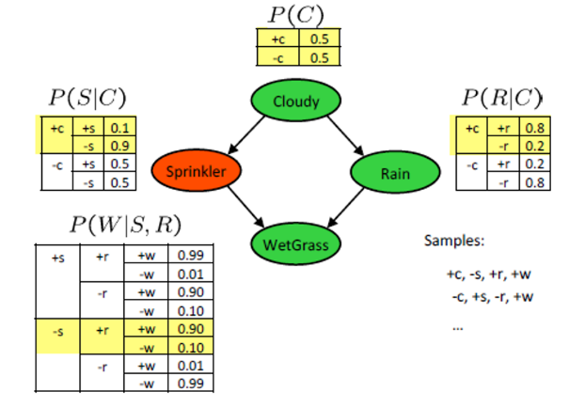
Prior sampling
Notes:
The order of choosing the variables for sampling must be consistent with the tree structure (always parents before children)

Slide 14
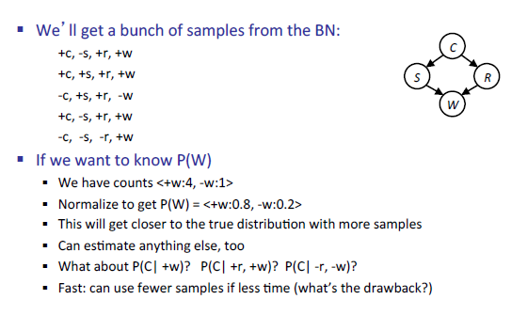
How to use the samples ?
Not computable from the samples we have
Accuracy

Slide 15
If we know the query in advance, can we sample more efficiently?
Yes!
Rejection sampling
Key idea : reject sample once an evidence variable has been sampled to take on a value inconsistent with the evidence of the query
Likelihood weighting
Key idea: rather than sampling the evidence variables, force them to be consistent with the evidence, and then re-weight the sample to account for the CPT’s of the evidence variables

Slide 16
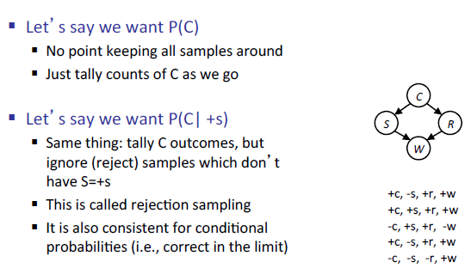
Rejection sampling
What if I want to compute a specific probability (not the joint distribution)?

Slide 17
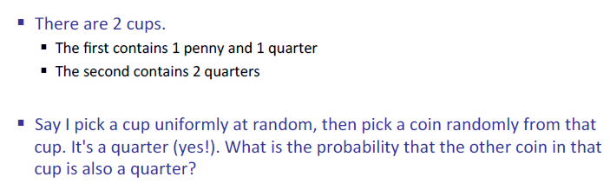
Example
Cup1, Quarter, Quarter → OK
Cup2, Penny → Nok
Cup2, Quarter, Penny → OK
Cup1, Quarter, Quarter → OK
Notes:
2/3

Slide 18
Likelihood weighting
Like in rejection sampling, we know the query ahead of time
Problem with rejection sampling:
If evidence is unlikely (and deep down in the BN), rejects lots of samples. We don’t know the sample is gone to be rejected before reaching the evidence variable
idea: fix evidence variables and sample the rest
Problem: sample distribution is not consistent
Solution: weight by probability of evidence given its parents
Example: P(Shape| color = Blue)
Shape | Color (evidence) | Weight
Pyramid | Blue | P(Blue | Pyramid)
Rectangle | Blue | P(Blue | Rectangle)
Pyramid | Blue | P(Blue | Pyramid)
Sphere | Blue | P(Blue | sphere)
… | … | …

Slide 19
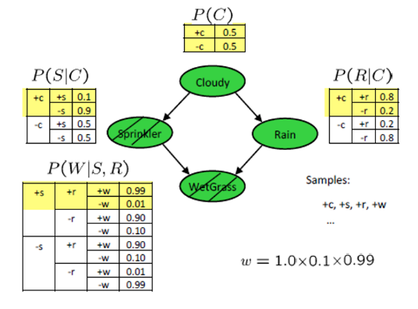
Example

Slide 20
Gibbs sampling
Likelihood weighting doesn’t solve all our problems
Evidence influences the choice of downstream variables, but not upstream ones (e.g. C isn’t more likely to get a value matching the evidence)
We would like to consider evidence when we sample every variable

Slide 21
Procedure
Procedure: Keep track of a full instantiation, x₁, x₂, …, x_{n}
Start with an arbitrary instantiation consistent with the evidence.
Sample one variable at a time, conditioned on all the rest, but keep evidence fixed
Keep repeating this for a long time
Property: in the limit of repeating this infinitely many times the resulting sample is coming from the correct distribution. Condition: No parameter is set to 0.
Rationale: both upstream and downstream variables condition on evidence
In contrast: likelihood weighting only conditions on upstream evidence, and hence weights obtained in likelihood weighting can sometimes be very small. (Sum of weights over all samples is indicative of how many “effective” samples were obtained, so want high weight.)

Slide 22
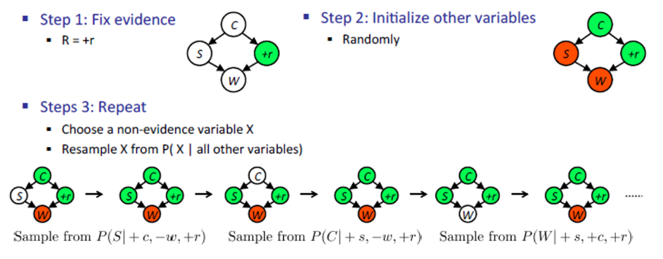
Example P(S|+r)
Can choose the same variable more than once
Gives you one sample from the correct P(S|+r) if run for long enough
Notes:
This method is called Markov Chain Monte Carlo
Markov again because we don’t care about the past and given the current sample we generate the future sample

Slide 23
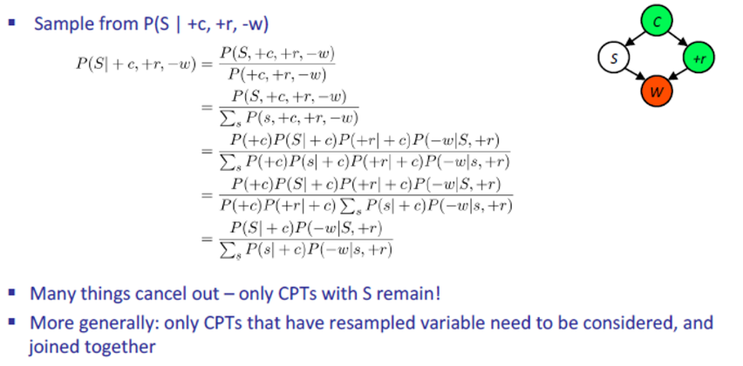
Efficient resampling of one variable
The mentioned procedure has exact inference queries! But it turns out they are easy to compute

Slide 24
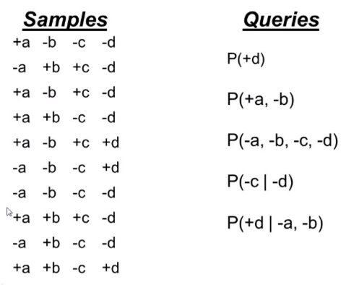
Ex1: Answer probabilistic queries from samples
Notes:
3/10
3/10
1/10
4/7
½

Slide 25
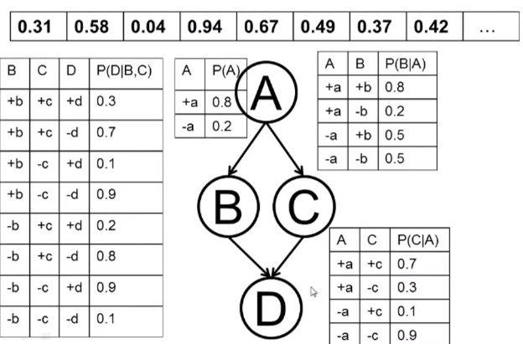
Ex2: rejection sampling, P(-d|-b)
Order: A, B, C, D
+a, +b → reject
+a, -b, +c, -d
…
+a
-a
0
0.8
1
0.31

Slide 26
Ex3: likelihood weighting P(-d|-a,-b)
Order: A, B, C, D
-a, -b, -c, +d
w= 0.2*0.5
-a, -b, +c, -d
w=0.2*0.5
…

Slide 27




Answering probabilistic queries from weighted samples
0.3
0.4
0.1
0.3
0.4
0.1
0.2
0.5
0.7
0.8
$$=\frac{0.4+0.1+0.8}{0.3+0.4+0.1+0.3+0.4+0.1+0.2+0.5+0.7+0.8}=\frac{1.3}{3.8}$$
$$=\frac{0.3+0.1+0.4}{3.8}=\frac{0.8}{3.8}$$
$$=\frac{0.2}{3.8}$$
$$=\frac{p(−c,−d)}{p(−d)}=\frac{0.3+0.3+0.2+0.7}{0.3+0.4+0.1+0.3+0.2+0.5+0.7 }=\frac{1.5}{2.5}$$
$$=\frac{p(+d,−a,−b)}{p(−a,−b)}=\frac{0.1}{0.1+0.2}=\frac{1}{3}$$

Slide 28
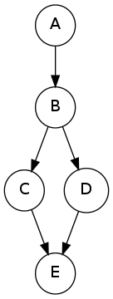
Ex 1
Assume the following Bayes Net and corresponding CPTs. In this exercise, we are given the query P(C|e=1), and we will complete the tables for each factor generated during the elimination process
After introducing evidence, we have the following probability tables
B A P(B|A)
0 0 0.700
1 0 0.300
0 1 0.600
1 1 0.400
A P(A)
0 0.800
1 0.200
C B P(C|B)
0 0 0.900
1 0 0.100
0 1 0.300
1 1 0.700
D B P(D|B)
0 0 0.800
1 0 0.200
0 1 0.800
1 1 0.200
C D P(e=1|C,D)
0 0 0.700
1 0 0.700
0 1 0.300
1 1 0.200

Slide 29
Ex 1 – cnt.
Three steps are required for elimination, with the resulting factors listed below:
Step 1: eliminate A. We get the factor f₁(B) = ∑_{a} P(a) P(B|a).
Step 2: eliminate B. We get the factor f₂(C,D) = ∑_{b} P(C|b) P(D|b) f₁(b).
Step 3: eliminate D. We get the factor f₃(C,e=1) = ∑_{d} P(e=1|C,d) f₂(C,d).
Note: After getting the final factor f₃(C, e=1), a final renormalization step needs be carried out to obtain the conditional probability P(C|e=1).
Notes:
Ans:
P(C=0|e=1)=0.715
P(C=1|e=1)=0.285

Slide 30
Ex2
Consider the graphical model shown below, where all variables have binary domains. We are given the query P(E|+f). Assume that we run variable elimination with the following ordering: D, A, B, C.
After introducing evidence, we have the following factors: P(A), P(B|A), P(C|A,B), P(D|C), P(E|A,C,D), P(+f|C,B,D)
Step 1: After joining on D and summing out over D, a new factor f₁ is generated, what are the variables and/or evidence of f₁?
What are the remaining factors ?
A
B
C
D
F
E
Notes:
C,E,A,B,+f
P(A), P(B|A), P(C|A,B), f1(A,B,C,E,+f)

Slide 31
Ex 2 – cnt
Step 2: eliminate A
What are the variables and/or evidence of f₂?
What are the remaining factors ?
Step 3: eliminate B
What are the variables and/or evidence of f₃?
What are the remaining factors ?
Step 3: eliminate C
What are the variables and/or evidence of f₄?
What are the remaining factors ?
Reminder: The final factor (or the product of final factors if there are more than one) is guaranteed to be equal to selected joint P(E,+f). To answer the original query, we need to renormalize to obtain P(E|+f)
Notes:
B, C, E, +f
f2(B,C,E,+f)
Step 3:
C, E, +f
f3(C,E,+f)
Step 4:
C, E, +f
F4(E,+f)

Slide 32
Ex 3: Rejecting sampling
In this question, we will perform rejection sampling to estimate P(C=1|B=1,E=1). Perform one round of rejection sampling, using the random samples given in the table below. Variables are sampled in the order A, B, C, D, E.
A P(A)
0 0.800
1 0.200
B A P(B|A)
0 0 0.800
1 0 0.200
0 1 0.600
1 1 0.400
E C D P(E|C,D)
0 0 0 0.200
1 0 0 0.800
0 1 0 0.600
1 1 0 0.400
0 0 1 0.600
1 0 1 0.400
0 1 1 0.600
1 1 1 0.400
C B P(C|B)
0 0 0.600
1 0 0.400
0 1 0.400
1 1 0.600
D B P(D|B)
0 0 0.800
1 0 0.200
0 1 0.400
1 1 0.600
0.745 | 0.874 | 0.047 | 0.037 | 0.767 | 0.517 | 0.840 | 0.372 | 0.264 | 0.261
Notes:
This sample will not be rejected because B’s value is 1 and E’s value is 1
A, B, C, D, E = 0, 1, 0, 0, 1

Slide 33
Ex 4: Estimating probabilities from samples
Below are a set of samples obtained by running rejection sampling for the Bayes' net from the previous question. Use them to estimate P(C=1|B=1, E=1). The estimation cannot be made whenever all samples were rejected.
sample1 0 1
A x
B x
C x
D x
E x
sample2 0 1
A x
B x
C
D
E
sample3 0 1
A x
B x
C x
D x
E x
sample4 0 1
A x
B x
C x
D x
E x
sample5 0 1
A x
B x
C
D
E
Notes:
Only one sample is accepted and C=1 in this sample then P(Q) = 1

Slide 34
Ex 5: Likelihood weighting
we will perform likelihood weighting to estimate P(C=1|B=1,E=1). Generate a sample and its weight, using the random samples given in the table below. Variables are sampled in the order A, B, C, D, E.
What is the weight for the sample you obtained?
A P(A)
0 0.200
1 0.800
B A P(B|A)
0 0 0.600
1 0 0.400
0 1 0.800
1 1 0.200
E C D P(E|C,D)
0 0 0 0.200
1 0 0 0.800
0 1 0 0.600
1 1 0 0.400
0 0 1 0.400
1 0 1 0.600
0 1 1 0.600
1 1 1 0.400
C B P(C|B)
0 0 0.200
1 0 0.800
0 1 0.200
1 1 0.800
D B P(D|B)
0 0 0.800
1 0 0.200
0 1 0.200
1 1 0.800
0.908 | 0.123 | 0.415 | 0.840 | 0.248 | 0.930 | 0.306 | 0.904 | 0.807 | 0.371
Notes:
0.2 * 0.6 = 0.12
1, 1, 0, 1, 1

Slide 35
Ex 6: Estimating probabilities from weighted samples
P(C=1|B=1,E=1)=?
0 1
A x
B x
C x
D x
E x
Weight = 0.12
0 1
A x
B x
C x
D x
E x
Weight = 0.08
0 1
A x
B x
C x
D x
E x
Weight = 0.08
0 1
A x
B x
C x
D x
E x
Weight = 0.08
0 1
A x
B x
C x
D x
E x
Weight = 0.08
Notes:
(0.12+0.08+0.08+0.08)/(0.12+0.08+0.08+0.08+0.08) =
0.8181818181818181

